Slide 1
User Acceptance Test
Complied by
Chan Ka-Keong
Lim Shu Fen
Chai Chee Wei
Stephen Chai
Oon Chien Hsiang
Shivaraman Arunkumar

Slide 2
Original Requirements (Functional)
When the user enters http://www.modestos.com.sg in the browser, the homepage should be displayed.
The homepage should display:
  the restaurant name at the top of the page
  the top navigation bar
  the animated side banner
  branch information
  Facebook page icon
  enquiry email link
  scrolling text showing latest promotion

Slide 3
Original Requirements (Functional)
The top navigation bar should be visible at all times.
The restaurant name at the top of the page should be visible at all times.
The branch information, including address and phone number, should be visible at all times.
When the user clicks one of the submenu of the ‘Menu’ menu at the top navigation bar, the PDF version of the restaurant menu should be displayed in a new browser tab.
When the user clicks one of the submenu of the Our Restaurant menu at the top navigation bar, the branch information, including address, phone number, business hours, branch description and photos of the venue should be displayed.

Slide 4
Original Requirements (Functional)
When the user clicks one of the submenu of the Promotions menu at the top navigation bar, the promotion information should be displayed.
When the user clicks Amici Di Modesto’s (it means Modesto’s friend) menu at the top navigation bar, the membership information should be displayed.
When the user clicks Career Opportunities of the Other Info menu at the top navigation bar, the career information at the restaurant and contact email should be displayed.
When the user clicks Gallery of the Other Info menu at the top navigation bar, a list of links to the photo galleries should be displayed.
On the list of photo galleries displayed, when the user clicks on any one of the link, the photo gallery showing thumbnails should be displayed.

Slide 5
Original Requirements (Functional)
On the photo gallery page, when the user clicks on any thumbnail, the enlarged version of the photo should be displayed and the user should be able to click on the edge of the photo to navigate.
When the user clicks on enquiries@modestos.com.sg at the bottom of the page, the default email client of the PC should be launched.
When the user clicks on the Facebook page icon at the bottom of the page, the restaurant Facebook page should be displayed in a new browser tab.
When the user clicks on the company name logo at the top of the page, the homepage of the restaurant should be displayed.

Slide 6
Original Requirements (Functional)
Online table reservation facility
  Auto-generate acknowledgement mail on receipt of reservation request
  Restaurant must obtain request with status ‘New’ within its inbox
  Restaurant must be able to ‘Confirm’ or ‘Reject’ the request
  Notification email (Confirm/Reject) will be sent to requestor

Slide 7
Original Requirements (Non-Functional)
Contents in the website should fit without any horizontal scrolling.
The web pages should be loaded within 3 seconds.
The colour used in web pages should be consistent with the colour scheme of the company.
URLs should be distinguishable from normal text, i.e. users should be able to tell that a URL is clickable.

Slide 8
Additional Requirement
The website must fulfill requirements in the following browsers
  Internet Explorer
  FireFox
  Chrome
  Safari

Slide 9
Objective of the Test Plan
To test new website for Modesto
To test the required features of new website.
To ensure that users are able to make reservations smoothly
Information is displayed clearly

Slide 10
Functions to be Tested
Need to test all required functions

Slide 11
Risk List
Refer to Risk List (Plan).xls

Slide 12
Approval and Sign off of Test Plan
Approval from Testing Team
Approval from PM
Approval from Client

Slide 13
Test Estimation
Refer to Test Estimation.xls

Slide 14
Strategy and Approach
Test Environment: Internet Explorer, FireFox, Chrome, Safari
Scope of Testing
  Test functional and non-functional requirements of the website
  Test new and enhanced functionalities
Roles and Responsibilities
  PM – Ka-Keong
  APM – Chien Hsiang
  Reviewer – Chee Wei
  Testers – Arunkumar, Shu Fen and Stephen

Slide 15
Test Schedule
Description | 1-Nov-2013
 | AM | PM
 | 10:00 – 12:30 | 1:30 - 2:30
Test planning
Review of test plan and approval for test execution
Test Environment Preparation
Execute the test
Test Procedure (status reporting etc)

Slide 16
Plan for Test Execution
Criteria to Start
  After getting approval from PM and client.
  After new build web host is delivered.
Suspension Criteria
  If 10 defects are received.
Resumption Criteria
  After half of the defects are resolved.
Test Completion Criteria
  5 defect

Slide 17
Test Procedure
Test project management
  Review every hour
  Gather information from project team
Status Reporting
  Every half an hour
Mechanism for change
  Review extensiveness of new features
  Re-schedule the test plan
Regulatory Compliance
  Comply with Internet law

Slide 18
Test Close-out Analysis
Test Scope
  Test functional and non-functional requirements of the website
  Test new and enhanced functionalities
  Regression Test (Test new features with old features)
  Performance test
  Test with different environment like IE, Firefox, etc

Slide 19
Resource Assigned
Name | Start Time | End Time
Arunkumar | 1:30 pm | 2:00 pm
Shu Fen | 1:30 pm | 2:00 pm
Stephen | 2:00 pm | 2:30 pm

Slide 20
Effort Analysis
No. | Scopes of work | Planned | Actual | Remarks
1 | Test planning & Preparation | 1.5 hrs | 2 hrs | Half an hour variance due to new requirements
2 | Test Execution | 1.5 hrs | 1 hr | Finish faster than expected.
3 | Total estimated effort for entire test | 2.5 hrs | 2.5 hr

Slide 21
Schedule Analysis
Task | Planning |  | Actual
 | Start Time | End Time | Start Time | End Time
Test Planning, Preparation, Execution and defect verification | 10:00 am | 2:30 pm | 10:00 am | 2:36 pm

Slide 22
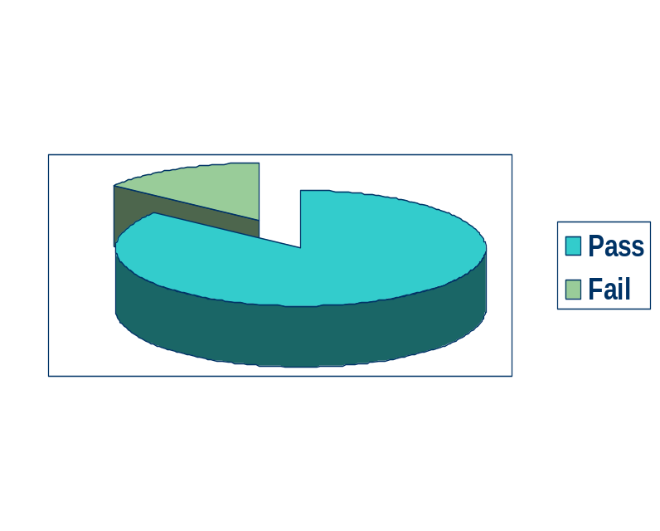
Defect Analysis
5 defects out of 69
Pass rate – 92.76%
Fail rate – 7.24%

Slide 23
Lessons Learnt
During preparation of the next release of the product, the test cases should be reviewed and improved.
Training for the client should be conducted before UAT is performed
A Test Readiness Review (TRR) should be practiced before UAT is conducted.

Slide 24
Proposal to the Project Team
Unit Testing and Integration Testing should be exhaustive for Key Requirement.
Requirements should be clarified so that no ambiguity exists.
Change Management should be factored into project plan.

